Slide 1
Make Your Home Safe For Independent Living
Karen Sandhu, HAFI Program
Notes:
1

Slide 2
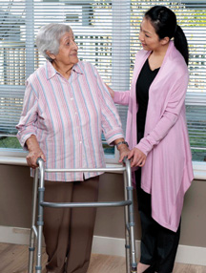
What is HAFI?
Home Adaptations for Independence (HAFI)
Financial assistance for eligible homeowners and tenants
Helps low-income seniors and people with disabilities remain in the comfort of their home
Promotes safe and independent living

Slide 3
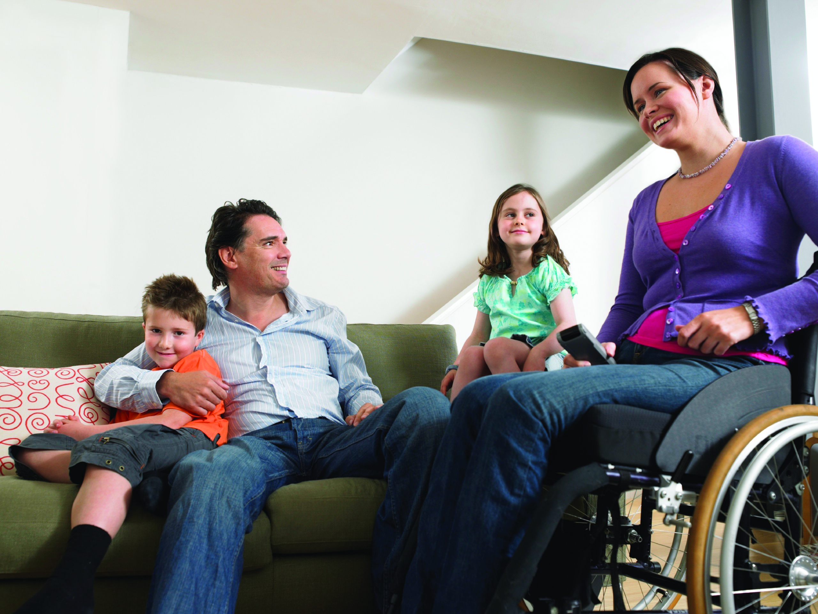
How is HAFI Funded?
Launched in January 2012
The HAFI program is funded by the Government of Canada and the Province of British Columbia

Slide 4
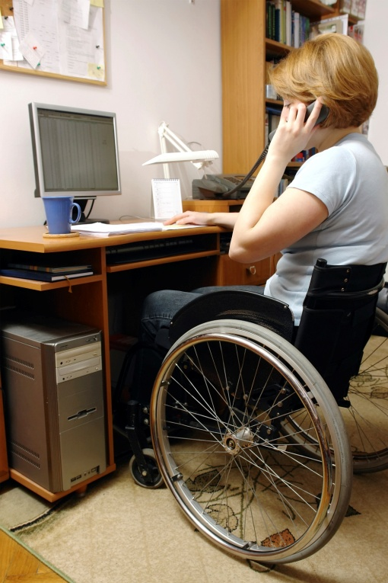
Eligibility
You may be eligible for assistance if you are a low-income senior or person with a disability
Living in your own home or in market rental accommodation
If you are an eligible tenant, you and your landlord will need to apply together
You must meet all eligibility requirements

Slide 5
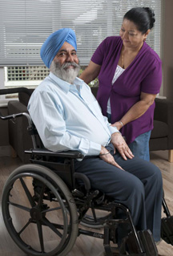
Eligibility Requirements
To qualify for assistance, you must meet the following requirements:
You are a Canadian citizen or landed immigrant and reside in B.C.
You have a permanent disability or loss of ability that makes daily activities difficult
The adaptations you are seeking are related to your disability or loss of ability
Your total household income and assets are below the limits established
For a detailed list of eligibility criteria, visit BC Housing’s website

Slide 6
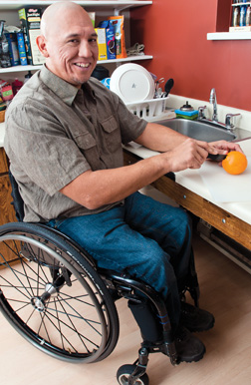
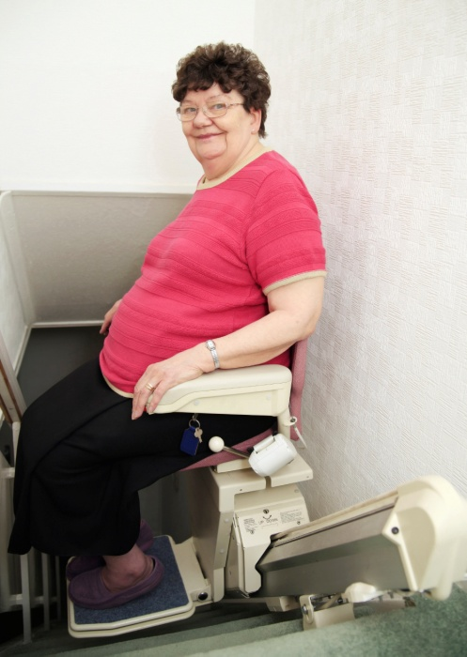
What Adaptations are Eligible?
All adaptations should be permanent and fixed to the home
For example:
Handrails in hallways or stairways
Ramps for ease of access
Easy to reach work and storage areas in the kitchen
Lever handles on doors
Walk-in showers or grab bars
Bathtub grab bars and seats

Slide 7
What Items are Not Eligible?
Here are examples of items that are not eligible:
Supportive care
Portable aids such as walkers
Household appliances
Repairs to roofs and furnaces or maintenance work

Slide 8
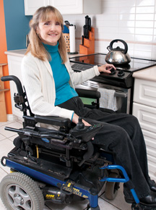
What Financial Assistance is Available?
Up to $20,000 per home
Additional assistance for common area modifications for strata and rental units
Additional assistance for underlying deficiencies for homeowners
Assistance is in the form of a grant or forgivable loan - depending on the amount

Slide 9
How Do I Apply?
To receive financial assistance, you must:
Qualify for the HAFI program and
Your application must be approved
Start by getting a copy of the application guide
3 Easy Steps:
Download the application form and guide from www.bchousing.org/HAFI
Call BC Housing at 604-433-2218 and ask for forms to be mailed to you
Visit any BC Housing Office in person

Slide 10
Eligibility Criteria for Richmond
Housing Income Limits (HILS):
One bedroom: $39,500
Two bedrooms: $48,000
Three bedrooms: $56,000
Four + bedrooms: $60,000

Slide 11
Eligibility Criteria for Richmond
Home Value Limits (HVLs):
Richmond, Delta and Tsawwassen
$649,999 or less
We look at the value listed on your 2014 BC Property Assessment

Slide 12
Eligibility Criteria for Richmond
Rent Affordability Limits (for Landlord/Tenant Applications):
One bedroom: $950
Two bedrooms: $1,170
Three bedrooms: $1,300
Based on the actual number of rooms in the home or unit

Slide 13
Need More Information?
For more information, contact:
HAFI
BC Housing
Homeowner Protection Branch
1701 - 4555 Kingsway, Burnaby, BC V5H 4V8
Phone:
Fax:
Toll-free:
604-433-2218
604-439-8550
1-800-257-7756 (ext. 18453)
www.bchousing.org/HAFI

Slide 14
Thank You
Notes:
14

